Slide 1


Computational Intelligence (TC2027)

Slide 2
Unit 5 – System Security (II)
Attack Vector
Input validation
Code Injection Attack
Buffer Overflow
General Defensive Strategies
Validation Strategies

Slide 3

Attack Vector

Slide 4
Attack Surface
A system’s attack surface is the subset of the system’s resources - methods (e.g., API), channels (e.g., sockets), and data - potentially used in attacks on the system.
Attack Surface of a Connected Vehicle
Manadhata, Pratyusa K., et al. An approach to measuring a system's attack surface. No. CMU-CS-07-146. CARNEGIE-MELLON UNIV PITTSBURGH PA SCHOOL OF COMPUTER SCIENCE, 2007.

Slide 5
System’s Attack Surface Risk
File System: malicious or inadvertent changes can corrupt system files that make up key functions of your system or grant access to private data;
User accounts: persistent rogue elevated accounts can grant access to hijack your system;
Network ports: can expose your system to unknown remote entities;
System Services: background process may be introduced that perform rogue operations like capturing sensitive data and even shut down existing key security modules;
Digital Certificates: determine what remote domains and package signatures are trusted; and
Registry: controls system startup actions, device drivers, services and more.

Slide 6
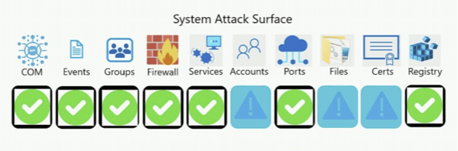
Attackability (or attack opportunity)
Intuitively, reduce the ways attackers can penetrate surface, increase the level of security.
Traditionally approach uses metrics based on counts number of bugs (founded or fixed), as for example counting the number of times a system version appears in bulletins and advisories.
However, we assume that there are certain system features that are more likely than others to be opportunities of attack.
The counts of these “more likely to be attacked” system features determine a system’s attackability.

Slide 7
Attack Vector x Payload
Don't confuse attack vectors with the payload that is carried out
Attack vectors: malicious email, attachments, worms, web pages, downloads, deception (social engineering), hackers.
Payloads: viruses, spyware, trojans, malicious scripting/executables.

Slide 8
Traditional Vector Based Attack Types
Buffer overflows attacks (string injection)
Code injection attacks also known as "code poisoning attacks“ examples:
Cookie poisoning attacks
HTML injection attacks
File injection attacks
Server pages injection attacks (e.g. ASP, PHP)
Script injection (e.g. cross-site scripting) attacks
Shell injection attacks
SQL injection attacks
XML poisoning attacks

Slide 9
Code Injection Attack

Slide 10
Input Validation
Input validation, also known as data validation, is the proper testing of any input supplied by a user or application.
Input validation prevents improperly formed data from entering an information system, through the the check and validation of all input entered into a system.
Incorrect input validation can lead to injection attacks, memory leakage, and compromised systems.

Slide 11
Input Validation
Sources of input
Command line arguments
Environment variables
Function calls from other modules
Configuration files
Network packets
Sources of input for web applications
Web form input
Scripting languages with string input

Slide 12
Input Validation Attack
An input validation attack occurs when an attacker deliberately enters malicious input with the intention of confusing an application and causing it to carry out some unplanned action.
Malicious input can include code, scripts and commands, which if not validated correctly can be used to exploit vulnerabilities.

Slide 13
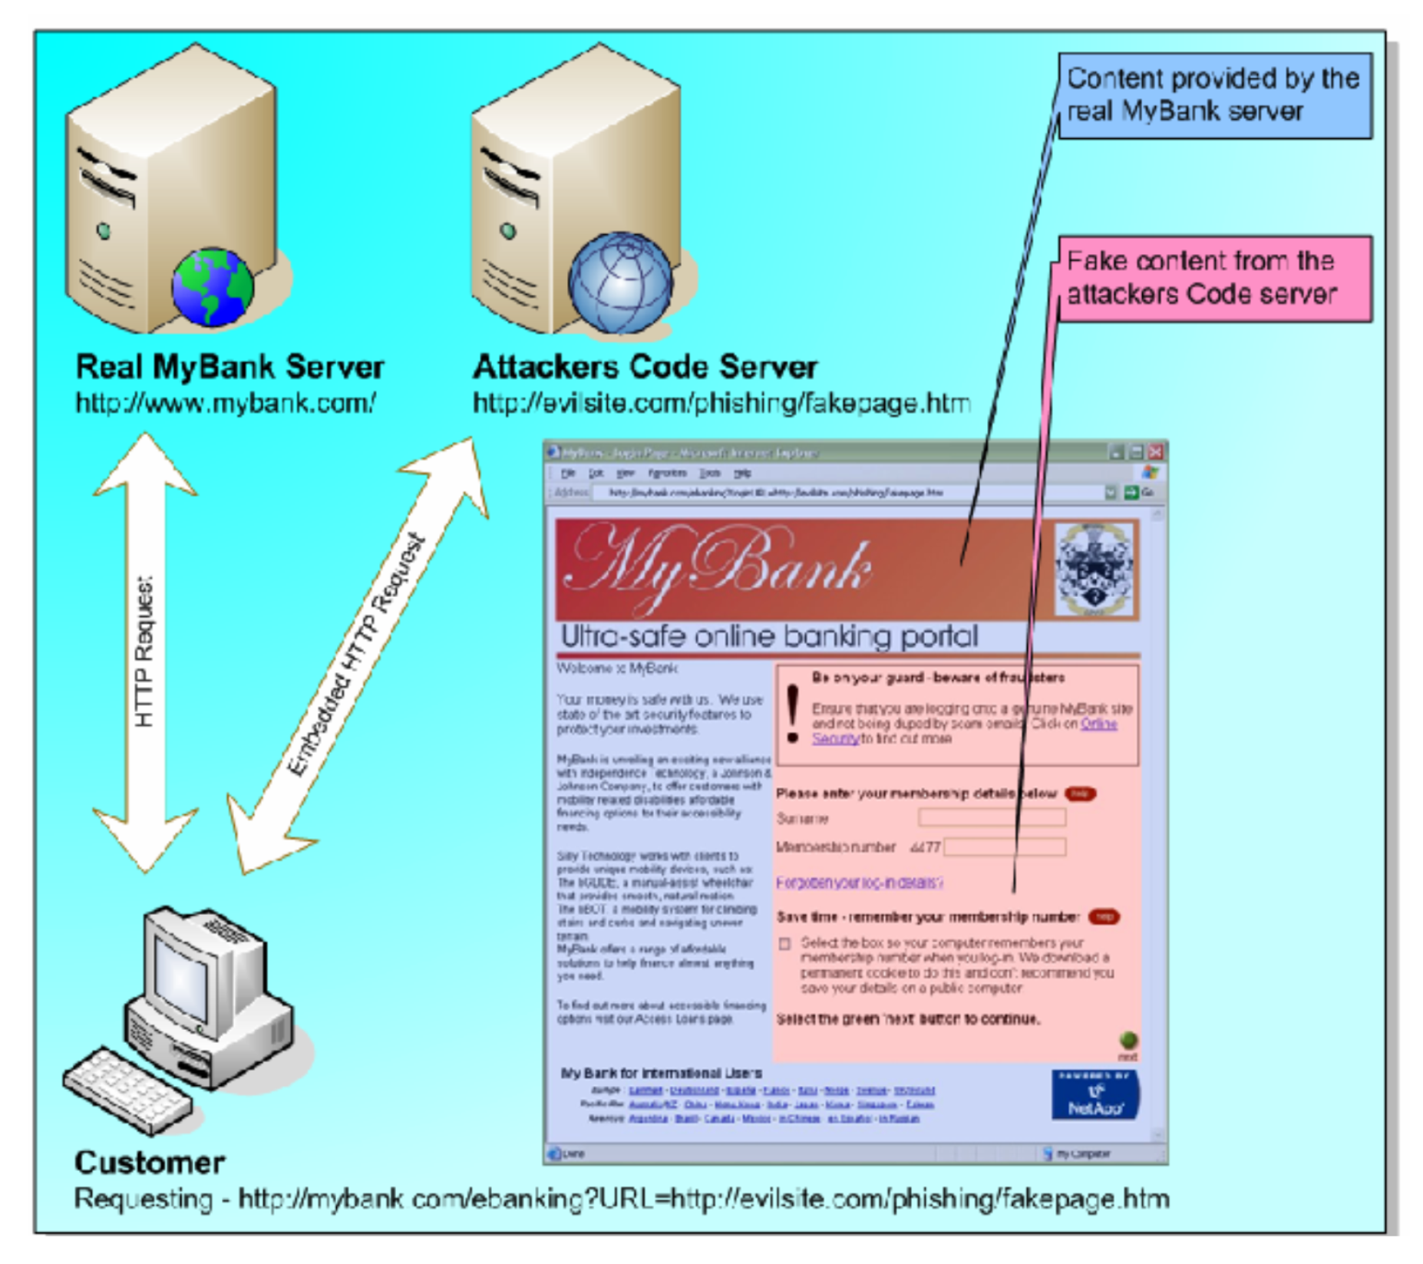
Input Validation Attack (Code Injection)
http://www.technicalinfo.net/papers/Phishing.html

Slide 14
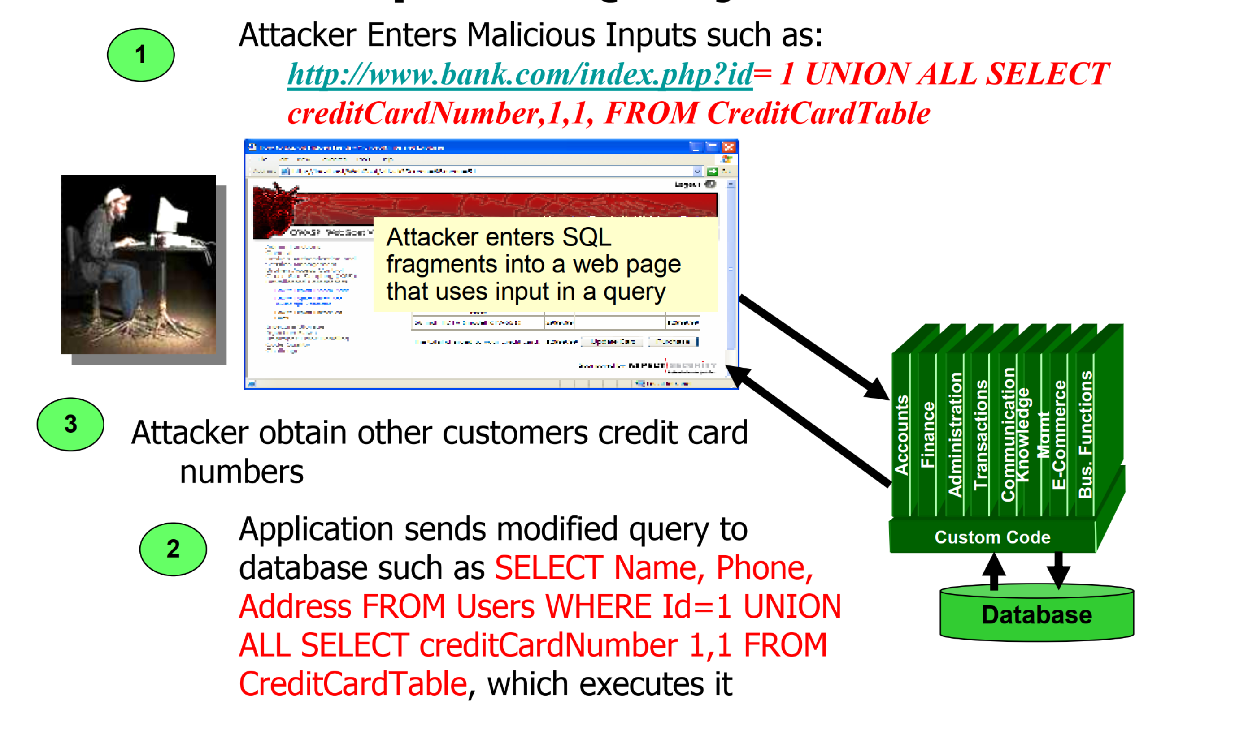
Input Validation Attack (SQL Injection)
http://www.owasp.org/index.php/Testing_for_SQL_Injection

Slide 15
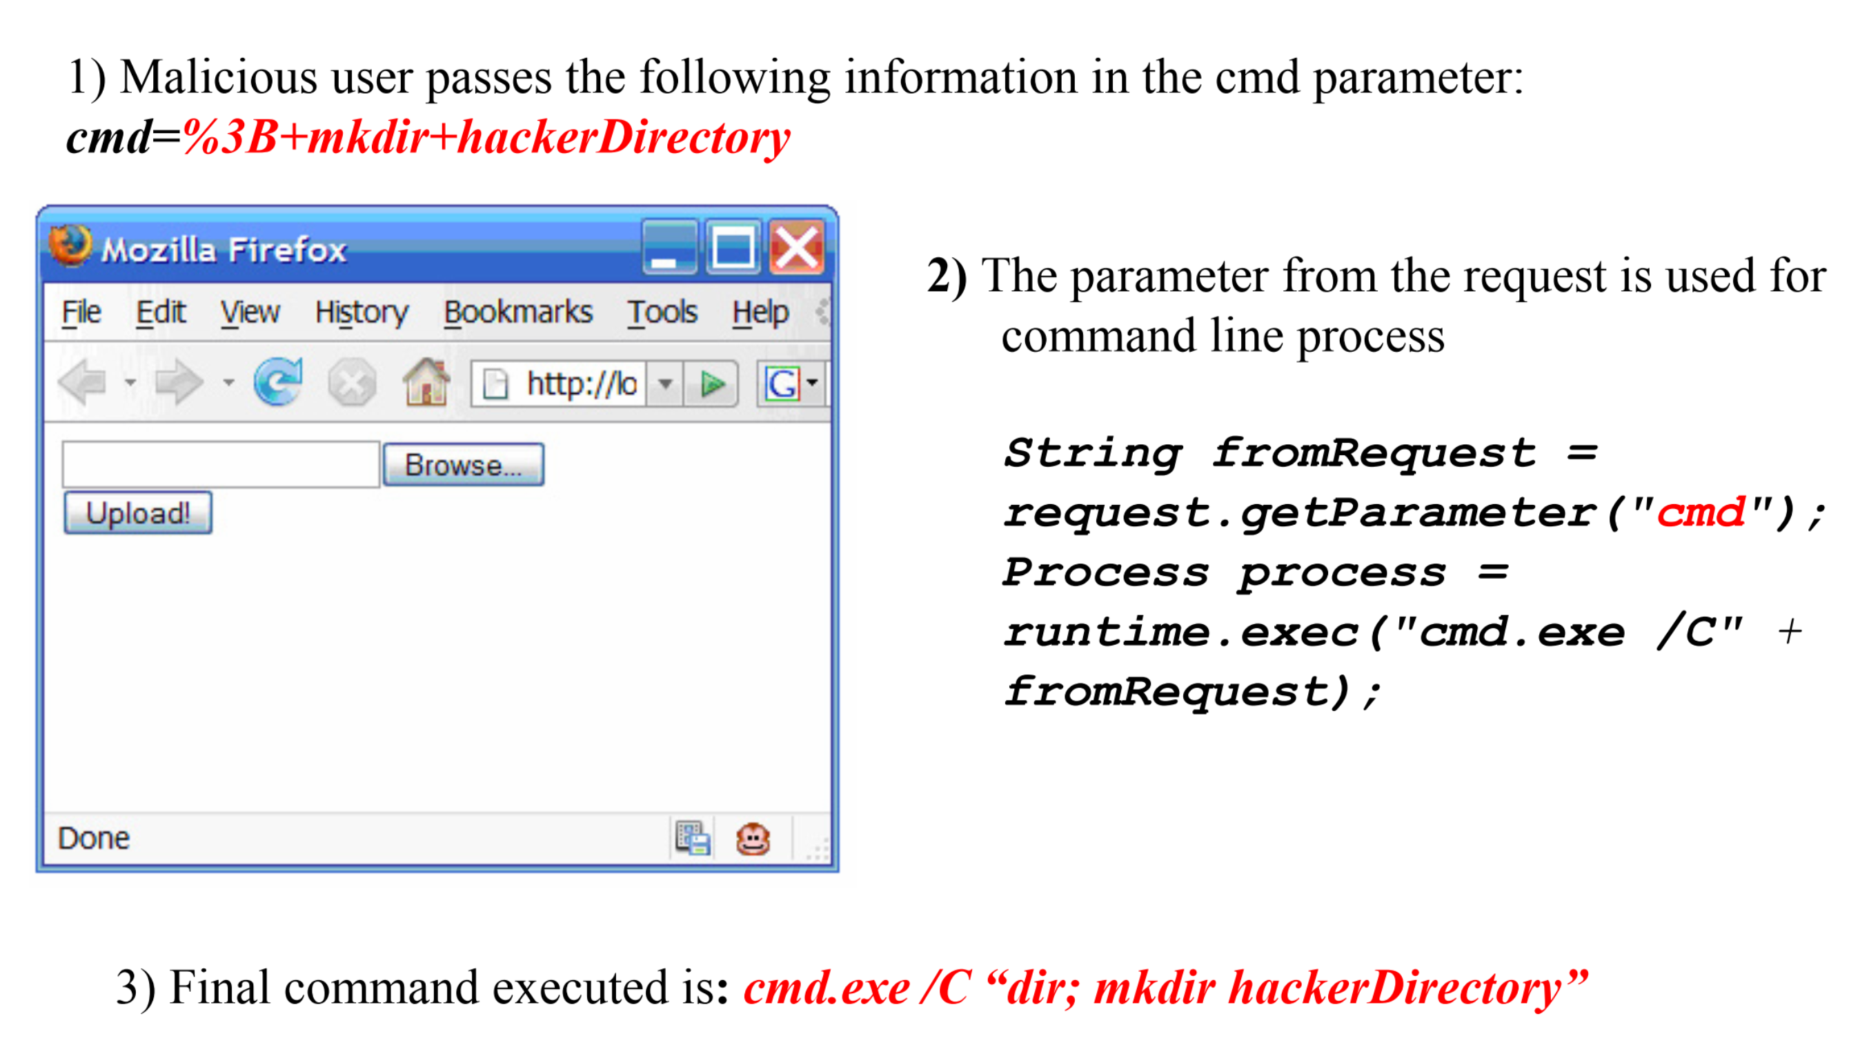
Input Validation Attack (Malicious File Upload)

Slide 16
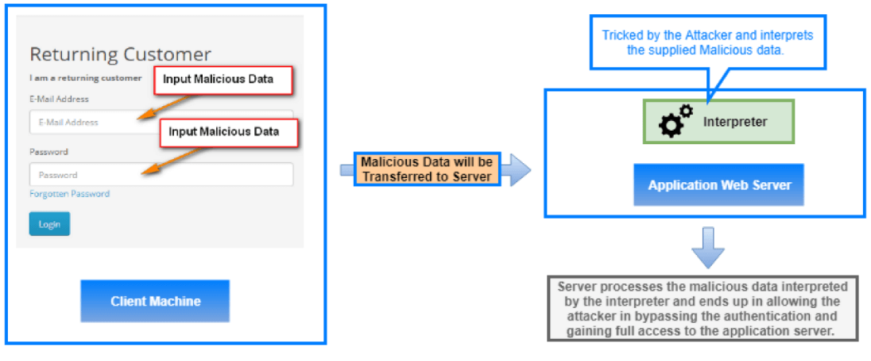
Input Validation Attack (Client-Side Validation Flaw)

Slide 17
New Web 2.0 Attack Vectors
Cross-site scripting in AJAX
XML Poisoning
Malicious AJAX code execution
RSS Atom Injection
WSDL scanning and enumeration
Client validation in AJAX routines
Web service routing issues
Parameter manipulation with SOAP
XPATH injection in SOAP message
RIA thick client binary vector

Slide 18
Attacker Perspective: Crafting Attack Vectors
Discover Entry Points: Identify first order injection and second-order injection (to attack resources directly) Fingerprint application server and technology
Scan and exploit known vulnerabilities
If not exploitable, try attack libraries, bypass filtering, exploit IV vulnerability patterns:
Input=>Output==XSS
Input=>Query (SQL, LDAP) ==(SQL, LDAP) injection
Input=>Code== Code injection
Input=>XML doc == XML injection
Input=>OS command==OS command injection
Input=> Fixed buffer or format string== overflow

Slide 19
Defense Perspective: Canonical Representation and Encoding
Fact: filtering out bad input is not easy as it sounds, and you can have may representations (i.e. more than just ASCII characters)
Canonicalization (c14n): the process of translating every string character to its single allowed (standard) encoding for each character

Slide 20
Buffer Overflow

Slide 21
Buffer Overflow
A buffer overflow, or buffer overrun, is an anomalous condition where a process attempts to store data beyond the boundaries of a fixed-length buffer.
The result is that the extra data overwrites adjacent memory locations. The overwritten data may include other buffers, variables and program flow data, and may result in erratic program behavior, a memory access exception, program termination (a crash), incorrect results or ― especially if deliberately caused by a malicious user ― a possible breach of system security.
Most common with C/C++ programs

Slide 22
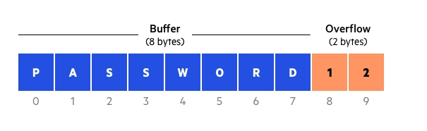
Buffer Overflow Example
For example, a buffer for log-in credentials may be designed to expect username and password inputs of 8 bytes, so if a transaction involves an input of 10 bytes (that is, 2 bytes more than expected), the program may write the excess data past the buffer boundary.

Slide 23
Types of Buffer Overflow
Stack-based buffer overflows are more common, and leverage stack memory that only exists during the execution time of a function.
Heap-based attacks are harder to carry out and involve flooding the memory space allocated for a program beyond memory used for current runtime operations.

Slide 24
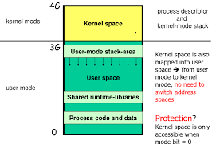
Linux Process Memory Layout
A process in the UNIX system can execute in two modes, kernel or user, it uses a separate stack for each mode.
The user stack is only used while the process is running in user mode.
The kernel stack is part of the kernel space. Hence, it is not directly accessible from a user process.
Whenever a user process uses a syscall, the CPU mode switches to kernel mode. During the syscall, the kernel stack of the running process is used.

Slide 25
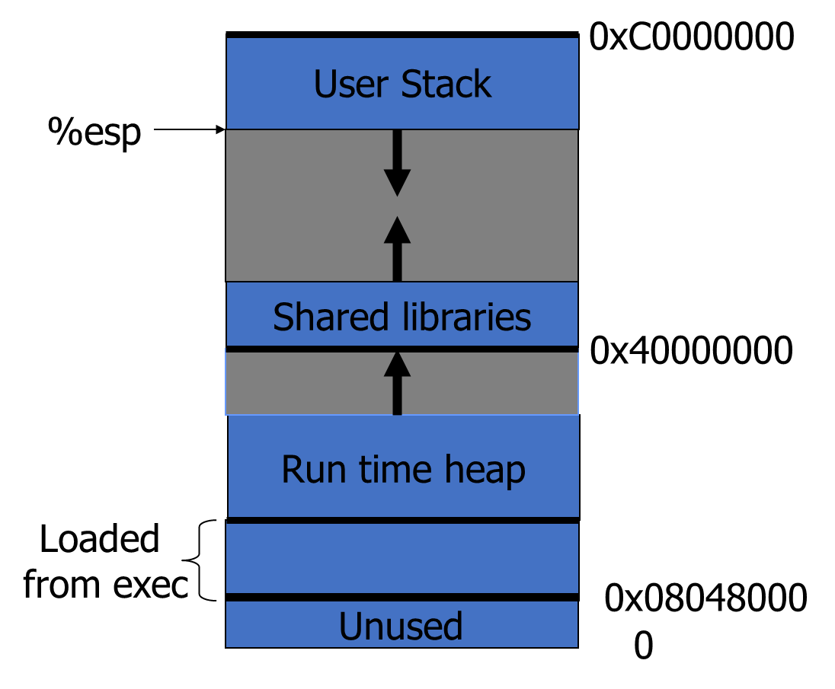
Linux Process Memory Layout
The user stack contains the arguments, local variables, and other data for functions executing in user mode.

Slide 26
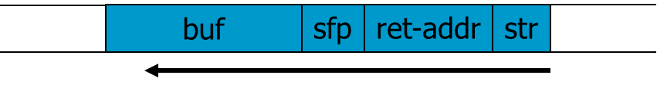
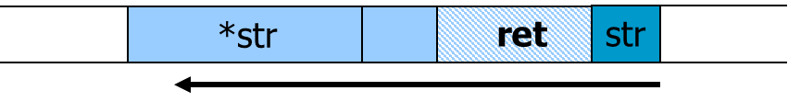
What are buffer overflows?
Suppose a web server contains a function: void func(char *str) { char buf[128];
strcpy(buf, str); do-something(buf); }
When the function is invoked, the stack looks like:
What if *str is 136 bytes long? After strcpy:

Slide 27
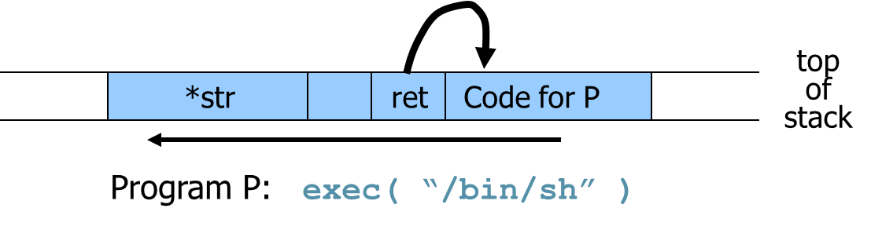
Basic stack exploit
Main problem: no range checking in strcpy().
Suppose *str is such that after strcpy stack looks like:
When func() exits, the user will be given a shell !!
Note: attack code runs in stack.
To determine ret guess position of stack when func() is called.

Slide 28
Some unsafe C lib functions
strcpy (char *dest, const char *src)
strcat (char *dest, const char *src)
gets (char *s)
scanf ( const char *format, … )
sprintf (conts char *format, … )

Slide 29
Exploiting buffer overflows
Suppose web server calls func() with given URL.
Attacker can create a 200 bytes URL to obtain shell on web server.
Some complications for stack overflows:
Program P should not contain the ‘\0’ character.
Overflow should not crash program before func() exits.

Slide 30
Heap Overflow
Heap overflow is a general term that refers to overflow in data sections other than the stack
buffers that are dynamically allocated, e.g., by malloc
statically initialized variables (data section)
uninitialized buffers (bss section)
Heap overflow may overwrite other date allocated on heap
By exploiting the behavior of memory management routines, may overwrite an arbitrary memory location with a small amount of data.
E.g., SimpleHeap_free() does
hdr->next->next->prev := hdr->next->prev;

Slide 31
Finding buffer overflows
Hackers find buffer overflows as follows:
Run web server on local machine.
Fuzzing: Issue requests with long tags. All long tags end with “$$$$$”.
If web server crashes, search core dump for “$$$$$” to find overflow location.
Some automated tools exist.
Then use disassemblers and debuggers (IDA-Pro) to construct exploit.

Slide 32
Preventing Buffer Overflow Attacks
Use type safe languages (Java, ML).
Use safe library functions
Static source code analysis.
Non-executable stack
Run time checking: StackGuard, Libsafe, SafeC, (Purify).
Address space layout randomization.
Detection deviation of program behavior
Access control to control aftermath of attacks… (covered later in course)

Slide 33
General Defensive Strategies

Slide 34
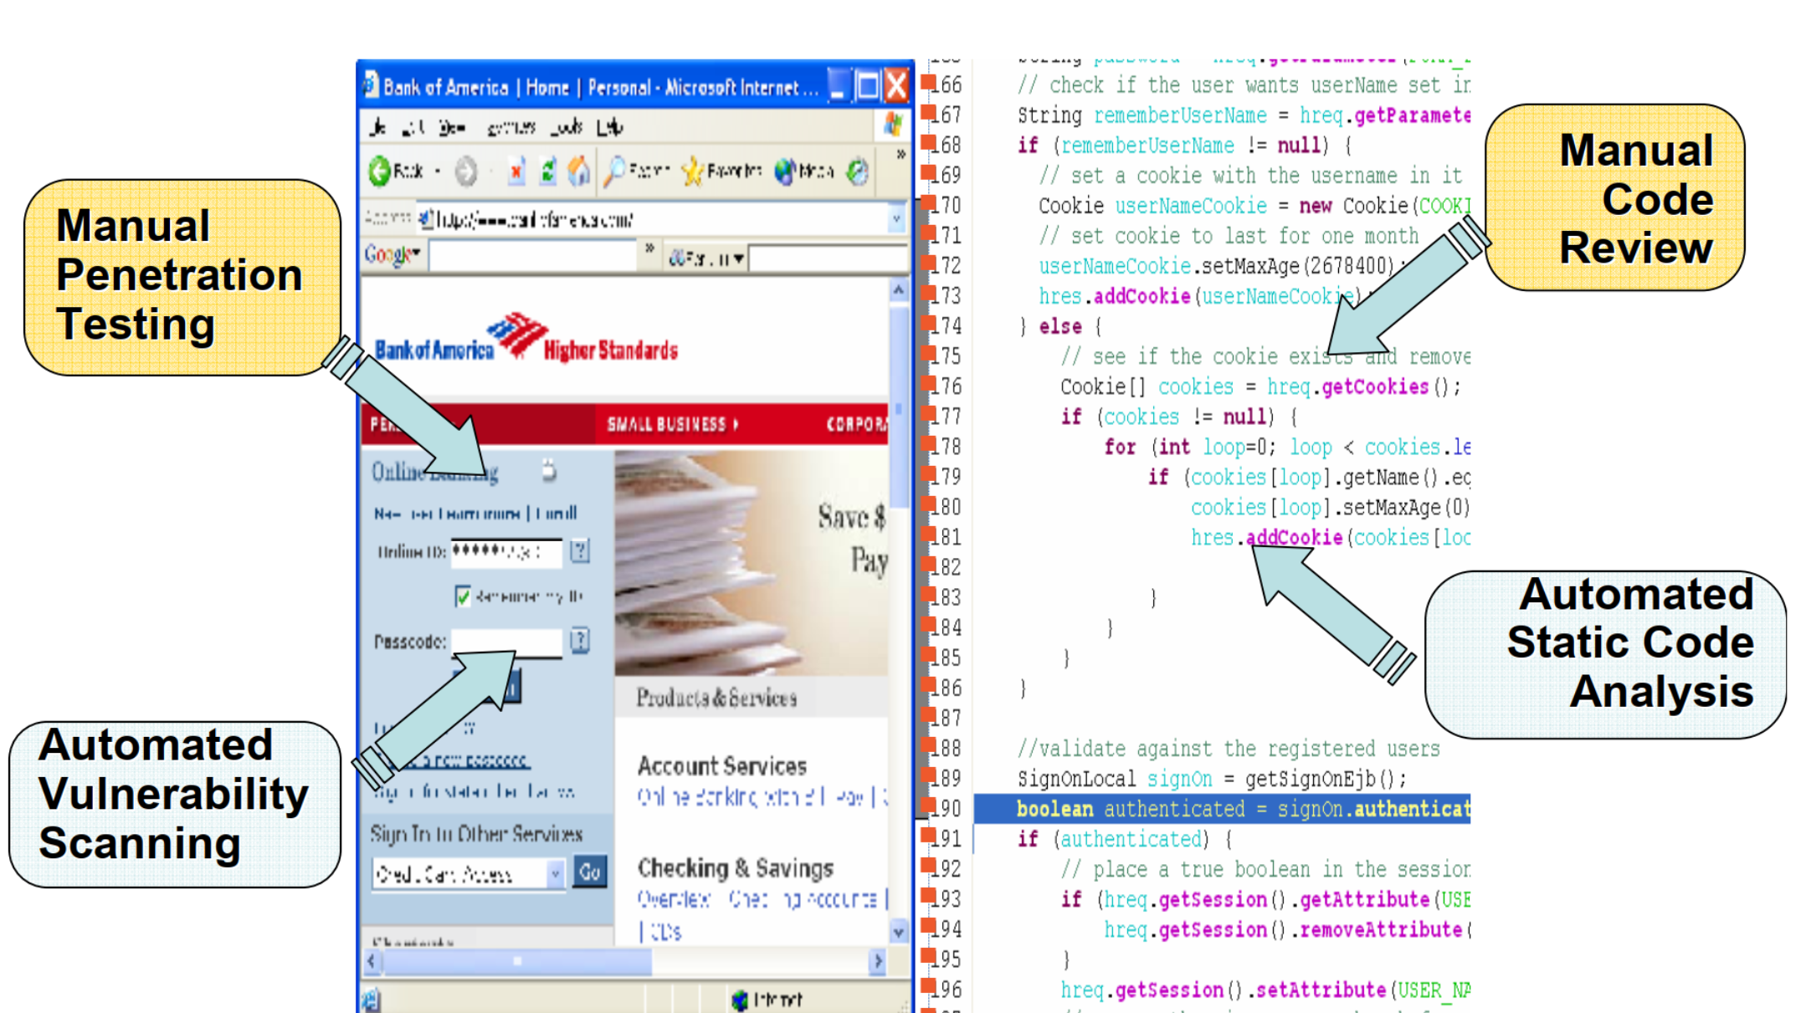
Web Application Security Assessment

Slide 35
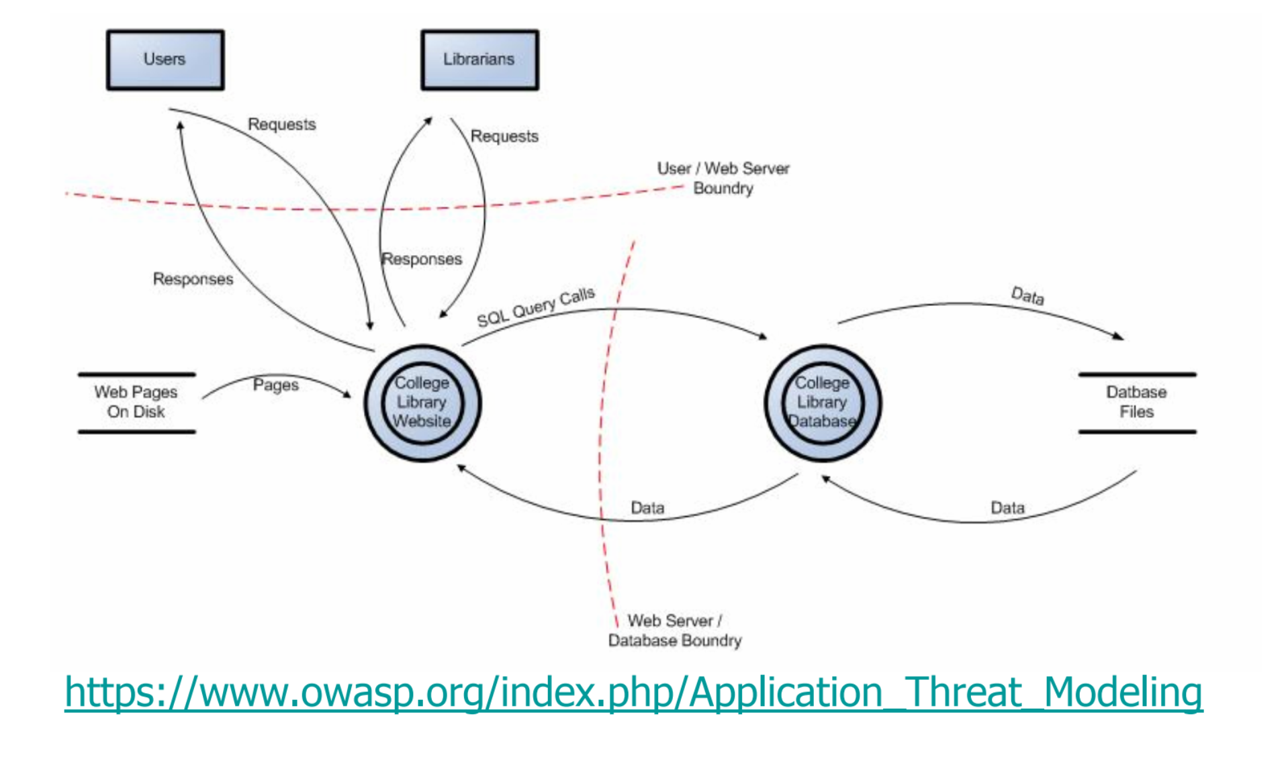
How to Find Input Validation Flaws: Application Threat Modeling

Slide 36
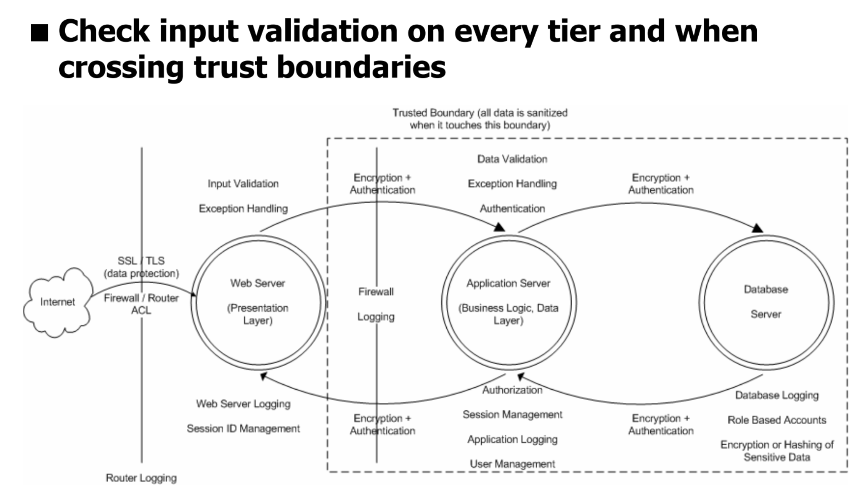
How to Find Input Validation Flaws: Secure Architecture Reviews

Slide 37
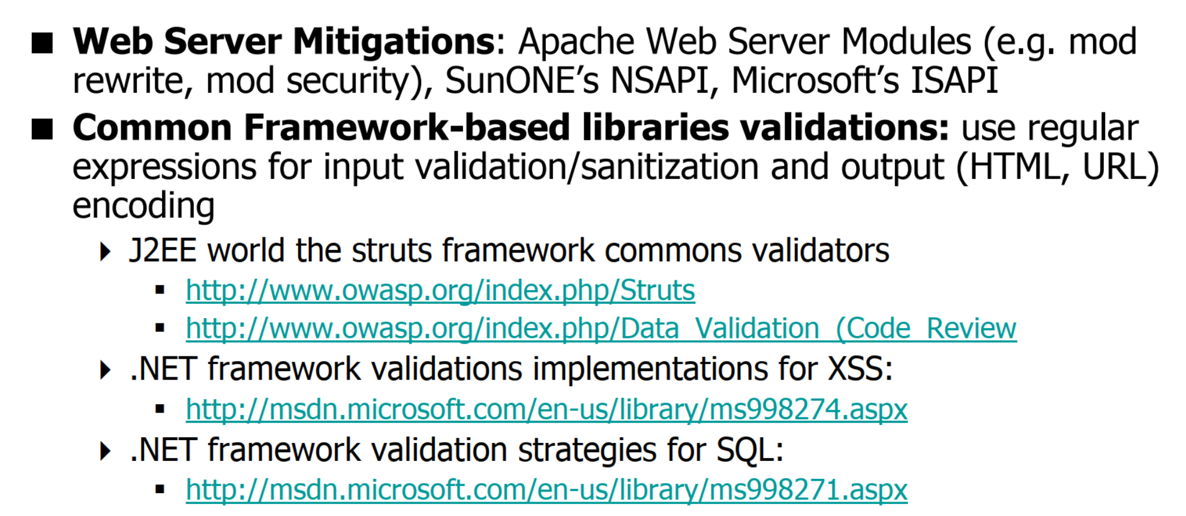
How to Protect Web Apps from attack vectors

Slide 38
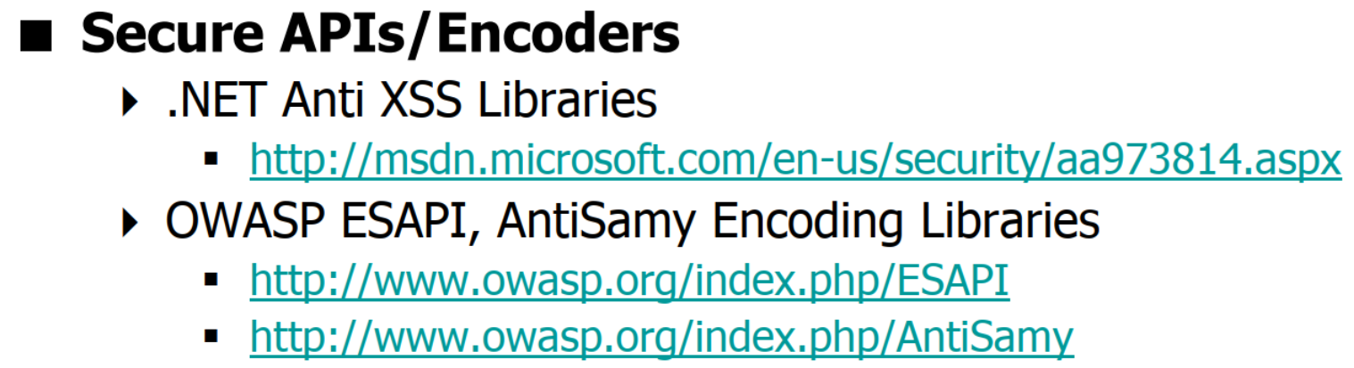
How to Protect Web Apps from attack vectors

Slide 39
Validation Strategies

Slide 40
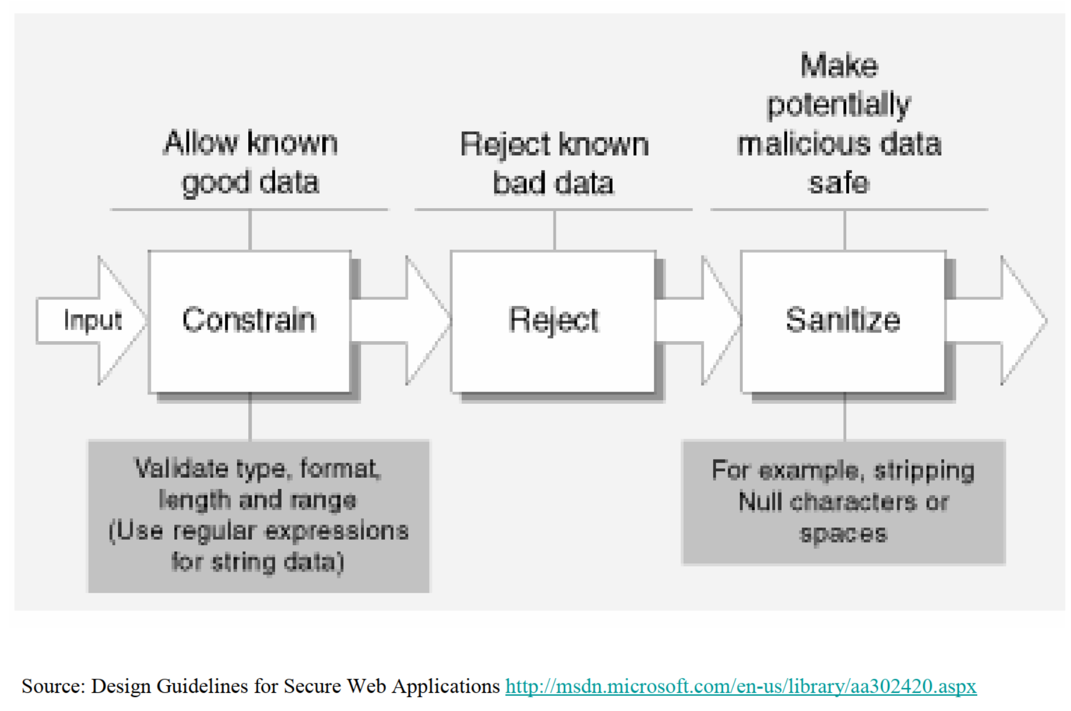
How to Validate?

Slide 41
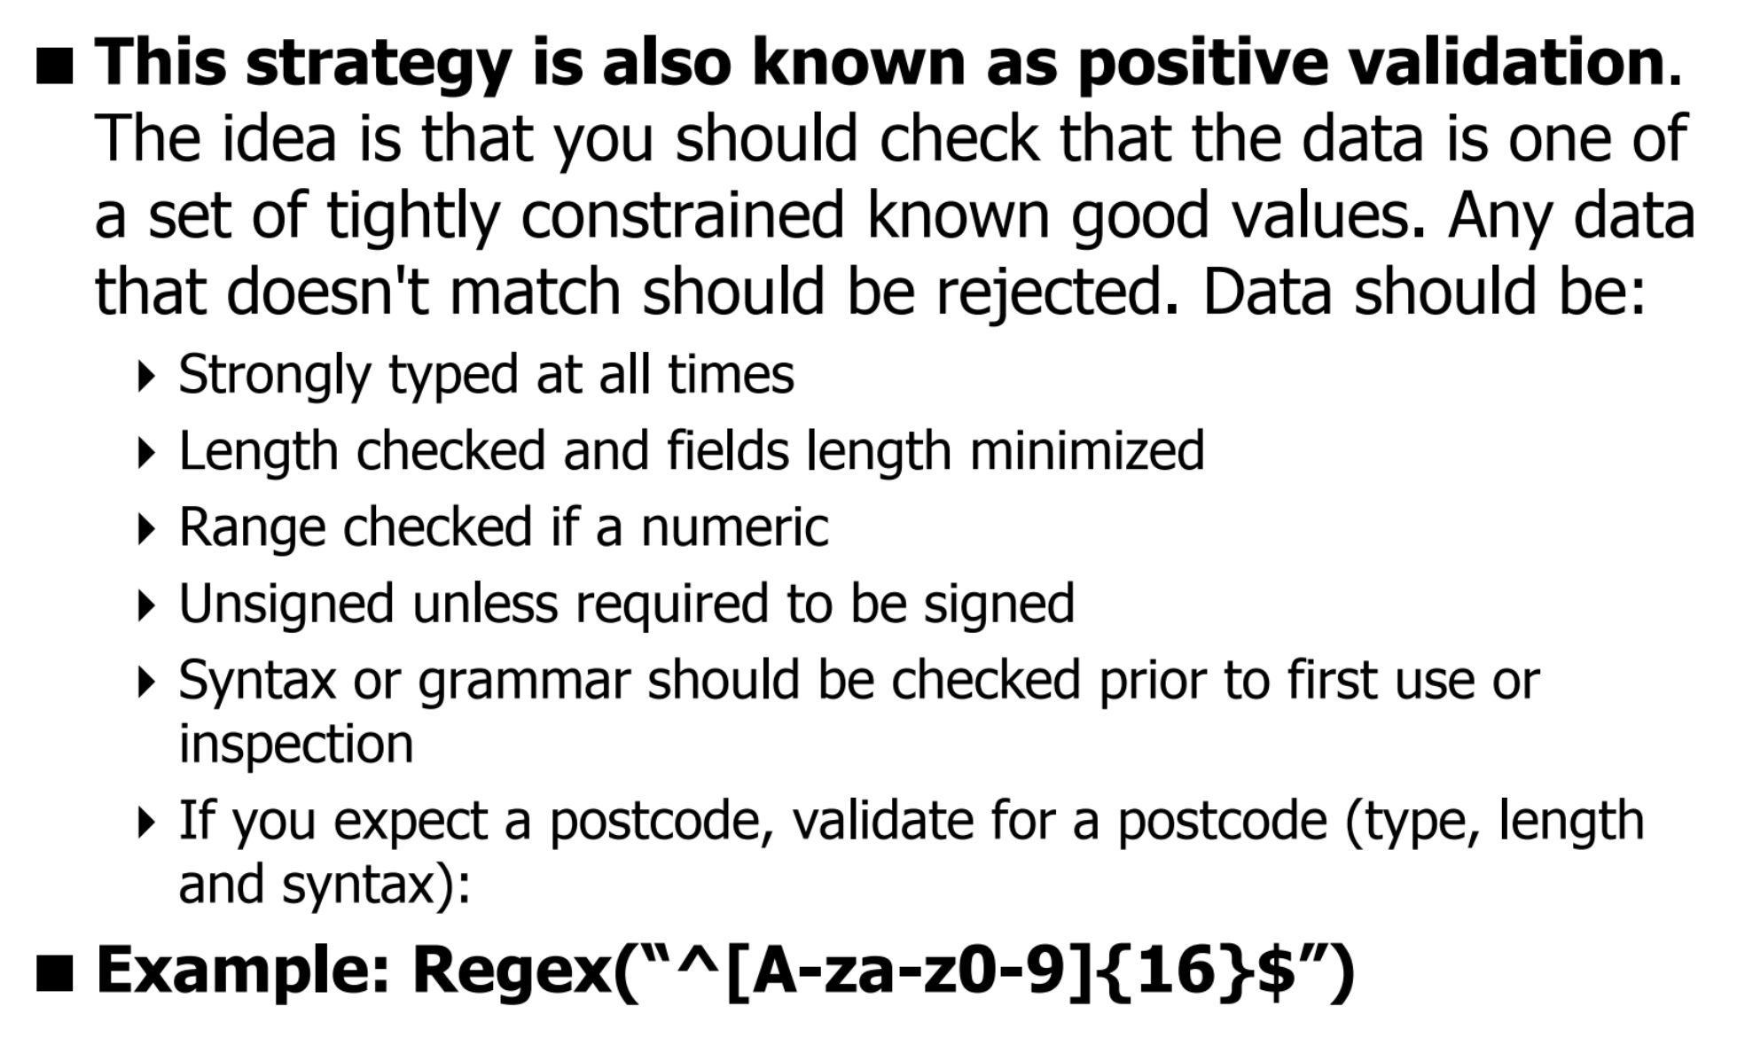
White-list filtering: Accept known good

Slide 42
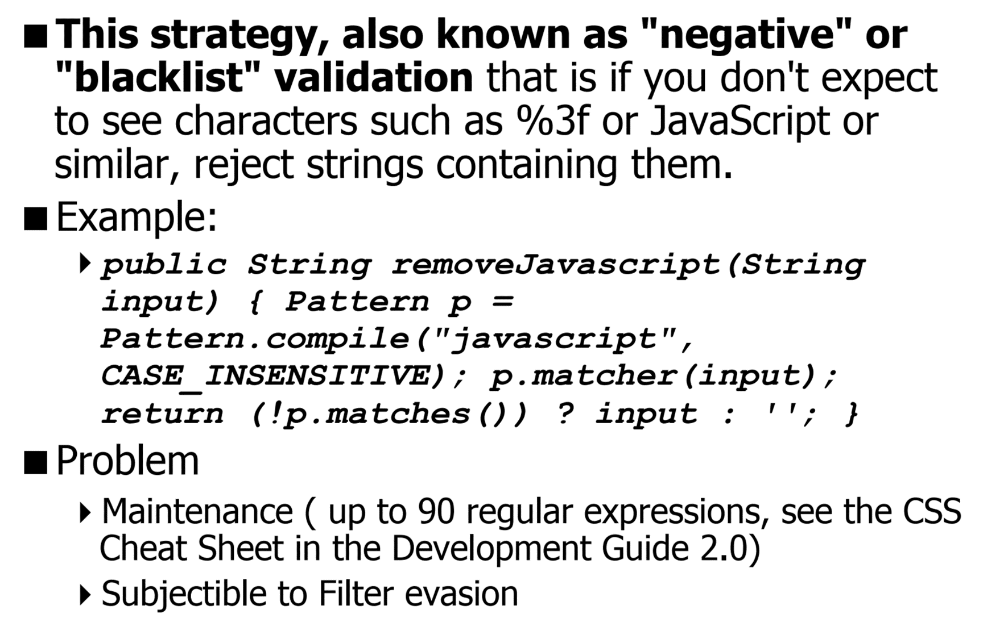
Black-List Filtering: Reject Known Bad

Slide 43
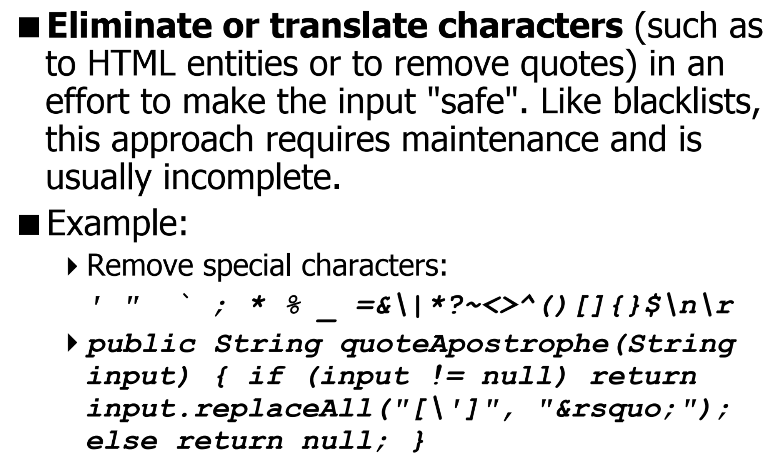
Sanitize or Canonicalize

Slide 44
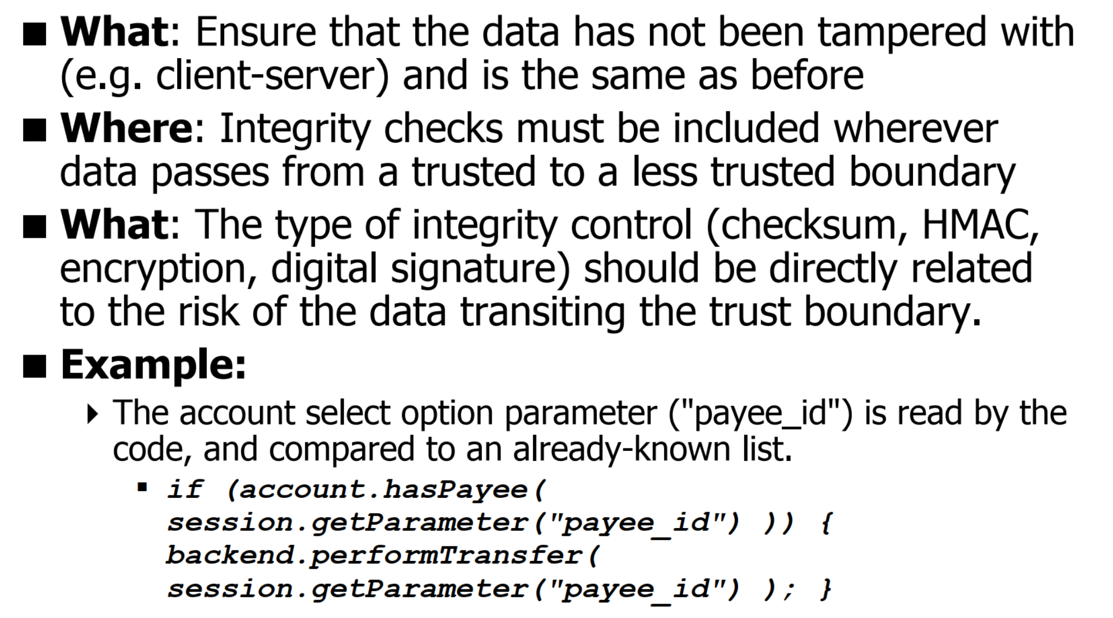
Data Validation: Include Integrity Checks (Server-Side Business Validations)

Slide 45
Unit 5 – System Security (II)
Attack Vector
Input validation
Code Injection Attack
Buffer Overflow
General Defensive Strategies
Validation Strategies

Slide 46
Computational Intelligence (TC2027)

